Slide 1
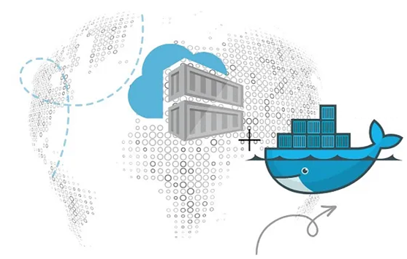
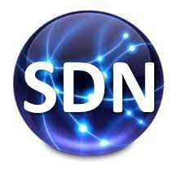
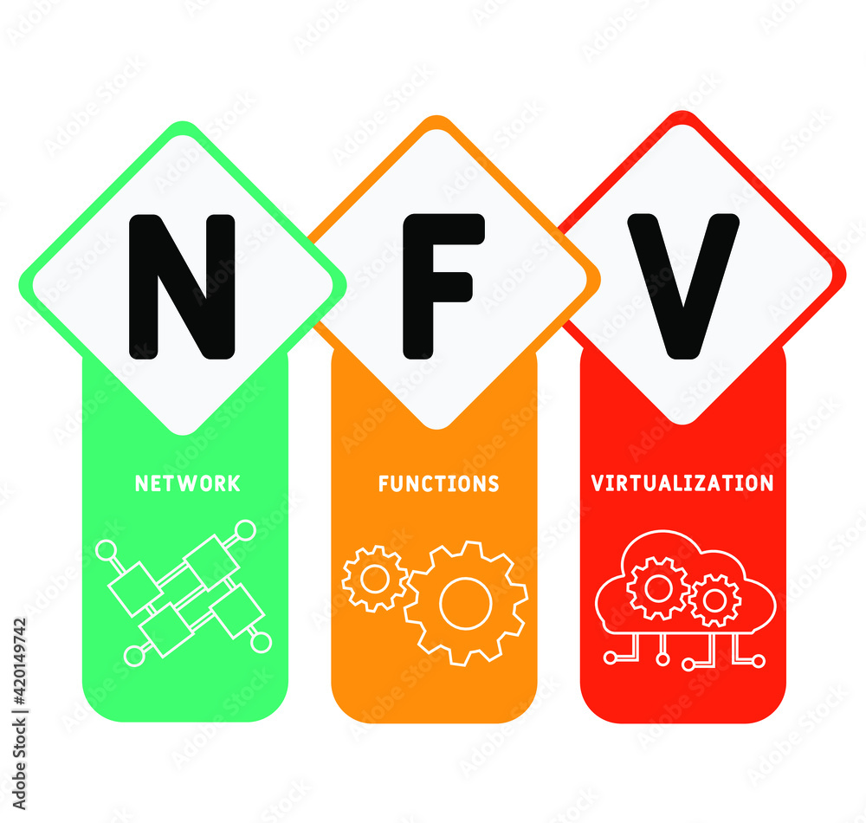
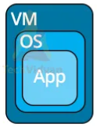
PDS
Computer Vision
Microservices:
Docker, Kubernetis, OpenSwift For Container
https://github.com/siagianp
https://www.youtube.com/@AmelOline/videos
Open TofU-IaC
https://github.com/amelcharolinesgn2/IoT_simulator-mqtt-NodeRed
https://github.com/amelcharolinesgn2/Cloud-Infrastructures
Notes:
https://roadmap.sh/aws
https://github.com/kubernetes-sigs/cluster-api-provider-kubevirt
https://roadmap.sh/aws
https://aws.amazon.com/what-is-cloud-computing/
https://www.ibm.com/think/topics/cloud-computing
3. https://www.ibm.com/topics/cloud-computing
4. https://csrc.nist.gov/pubs/sp/800/145/final
https://csrc.nist.gov/pubs/sp/800/145/final
https://docs.openstack.org/liberty/install-guide-rdo/overview.html
https://kubernetes.io/blog/2024/04/05/diy-create-your-own-cloud-with-kubernetes-part-3/

Slide 2
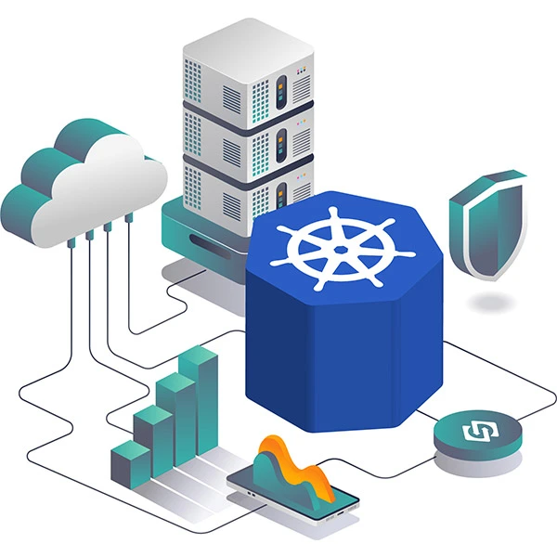
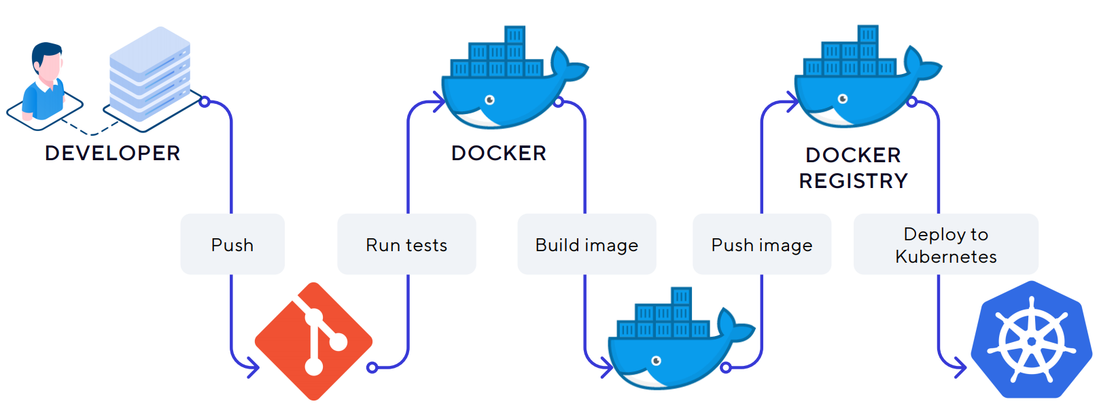
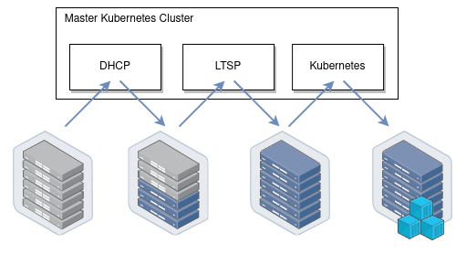

Slide 3
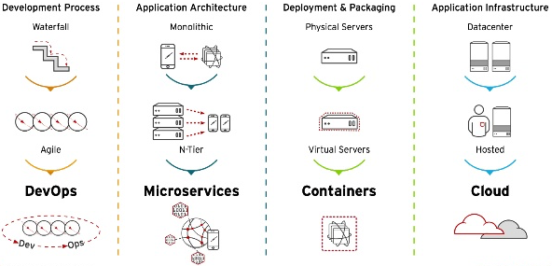
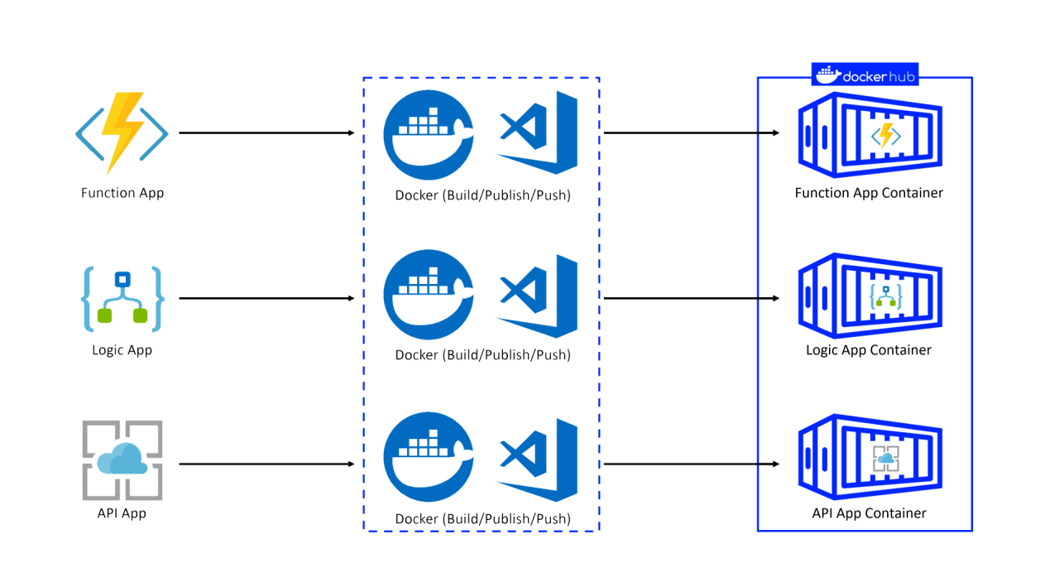
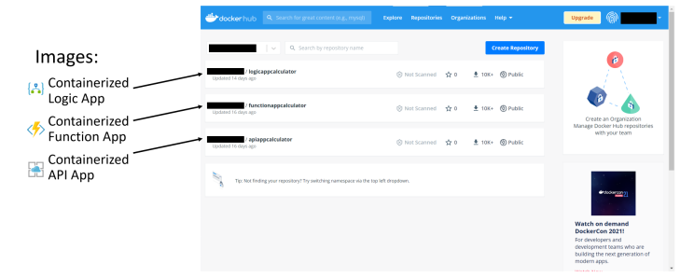
Microservices: Containerize Serverless
Microservices
Notes:
https://www.linkedin.com/pulse/microservices-containerize-serverless-tarun-sharma

Slide 4
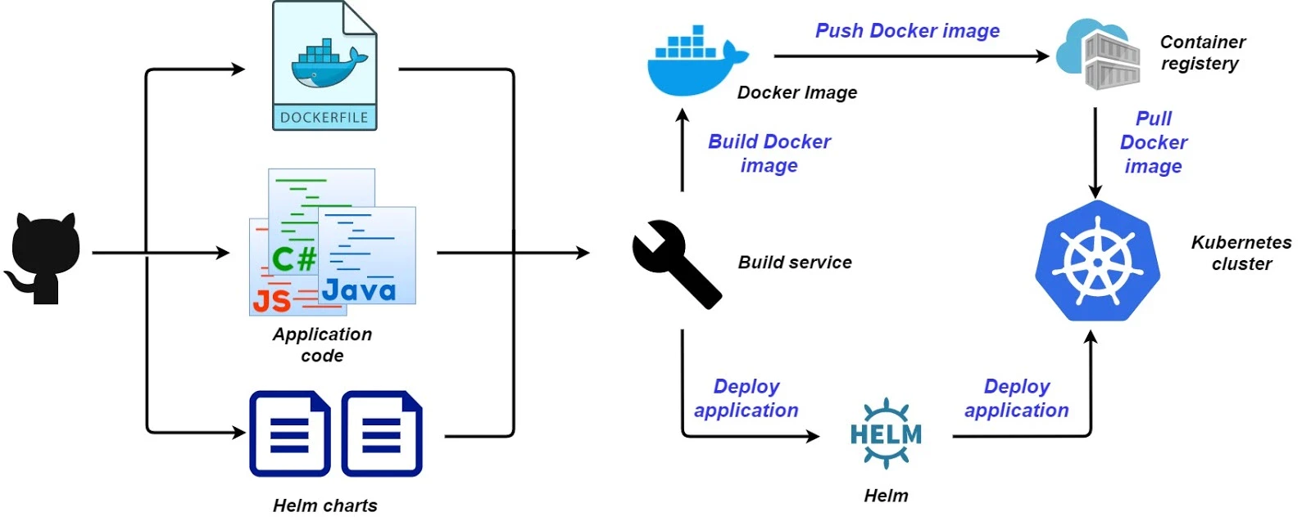
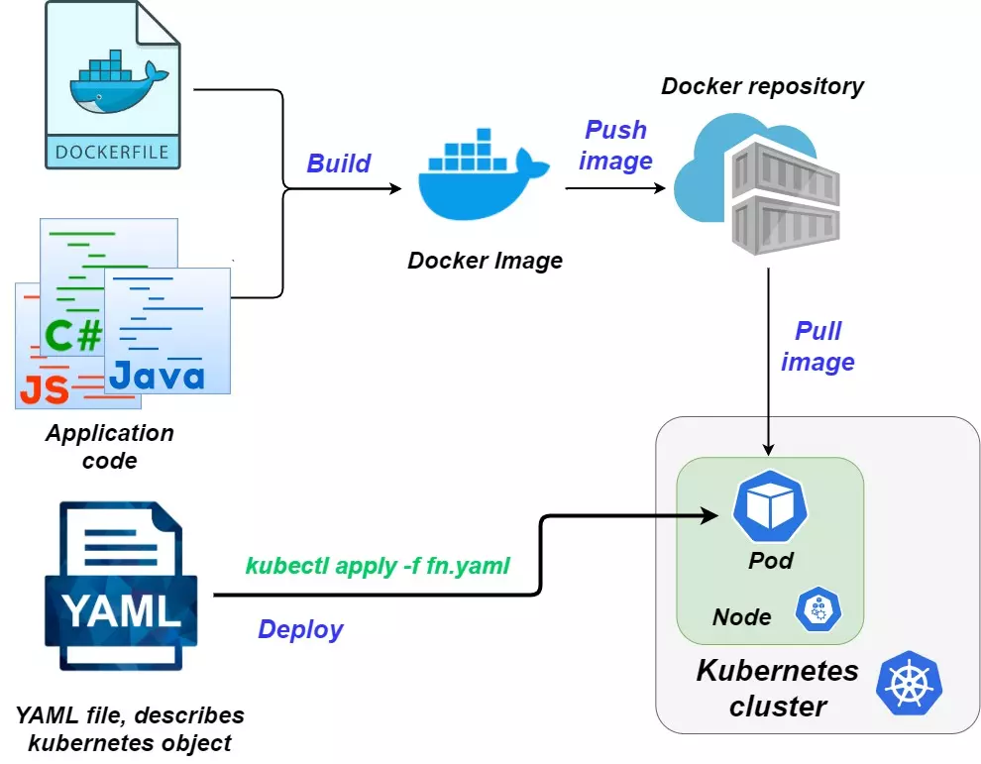
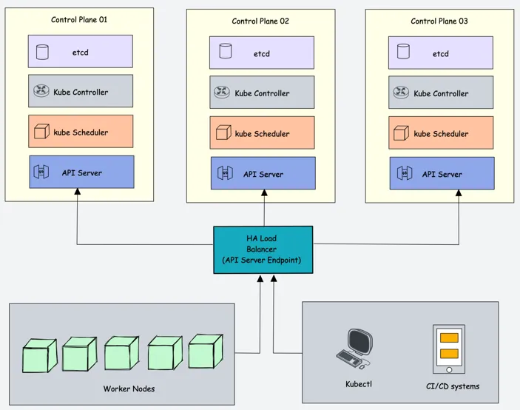
Notes:
https://devops.fastdev.com/articles/kubernetes-as-a-modern-platform-for-enterprise.html
https://builder.aws.com/content/2rILoggeyIx0aGMg1Lm4OEgIMWp/deploying-applications-with-high-availability-on-kubernetes

Slide 5
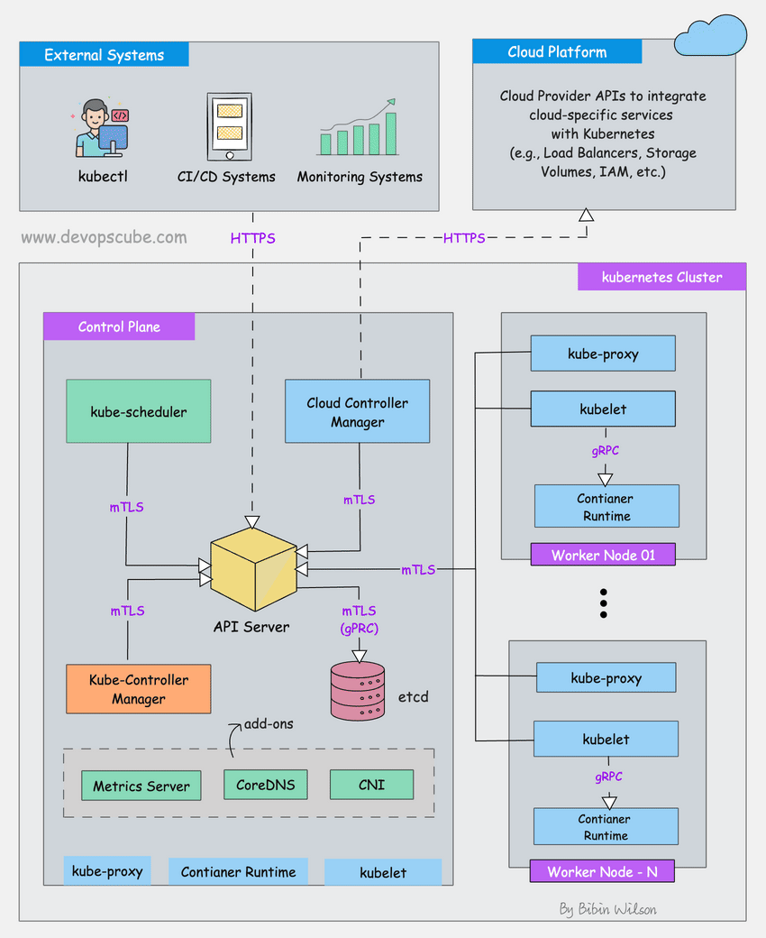
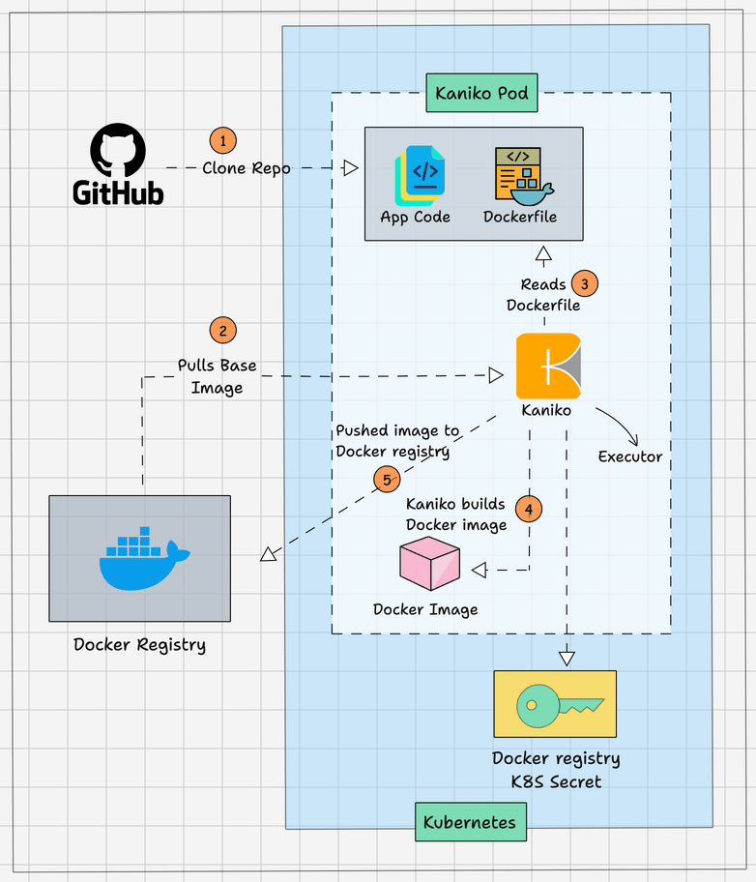
Docker Image in Kubernetes Pod
Kaniko supports the following type of build context.
GCS Bucket
S3 Bucket
Azure Blob Storage
Local Directory
Local Tar
Standard Input
Git Repository
Notes:
https://devopscube.com/build-docker-image-kubernetes-pod/
https://blog.stackademic.com/advanced-end-to-end-devsecops-kubernetes-three-tier-project-using-azure-aks-fluxcd-prometheus-cca3c5e61953
https://devopscube.com/kubernetes-architecture-explained/

Slide 6
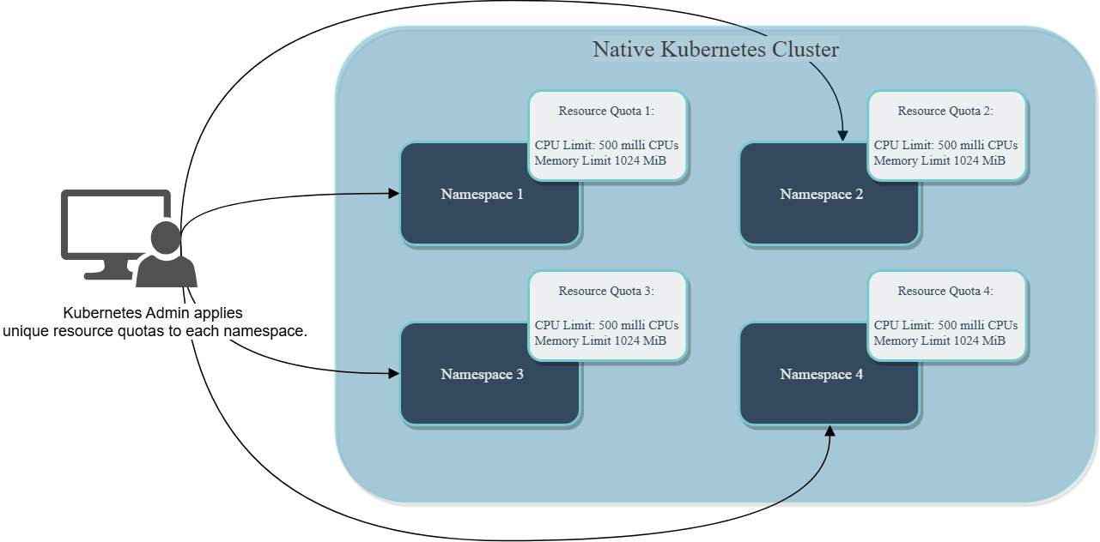
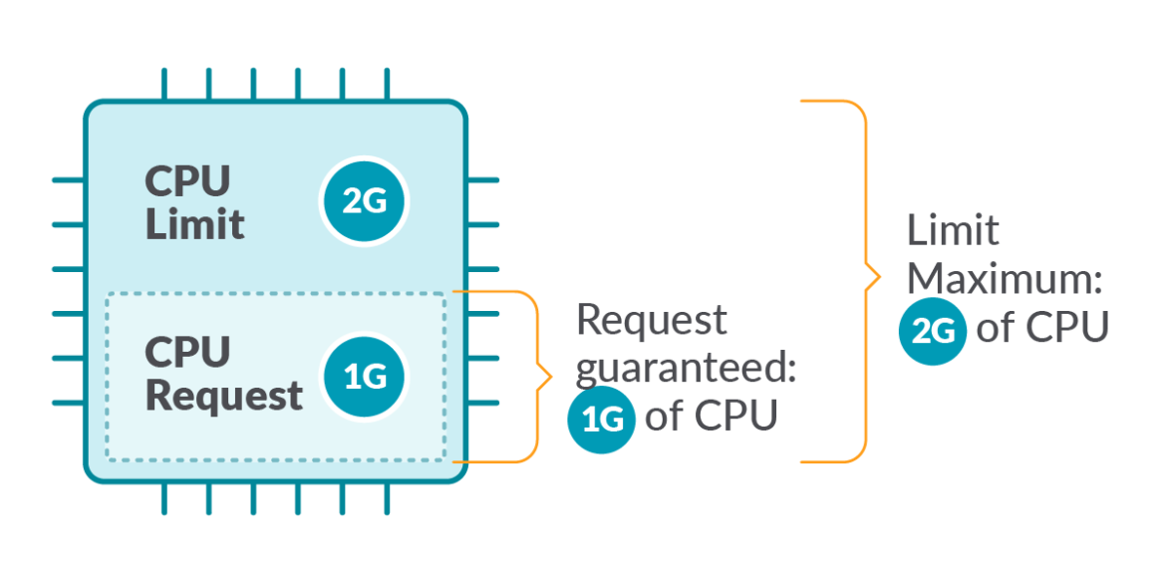
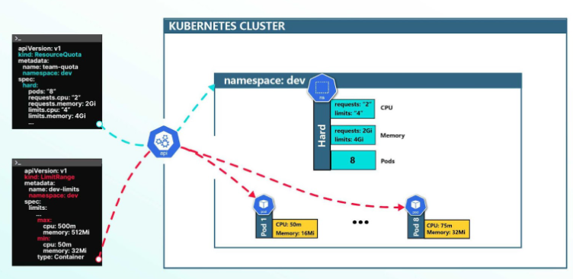
Resource Management for Pods and Containers
The kubelet starts a container as part of a Pod, the kubelet passes that container's requests and limits for memory and CPU to the container runtime.
How Kubernetes applies resource requests and limits
Resource Management for Pods and Containers
Notes:
https://kubernetes.io/docs/concepts/configuration/manage-resources-containers/
https://kubernetes.io/docs/tasks/configure-pod-container/assign-memory-resource/
https://ranchermanager.docs.rancher.com/how-to-guides/advanced-user-guides/manage-projects/manage-project-resource-quotas/about-project-resource-quotas

Slide 7
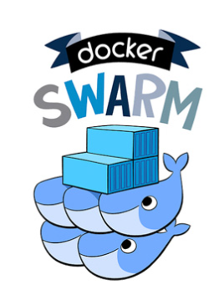
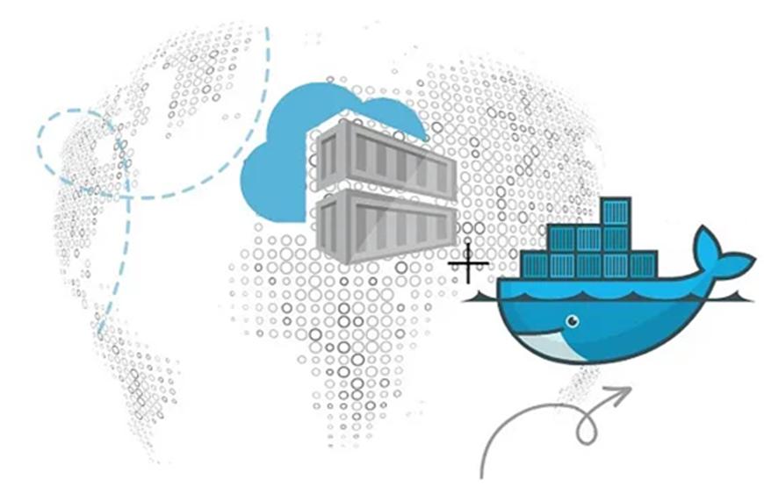
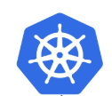
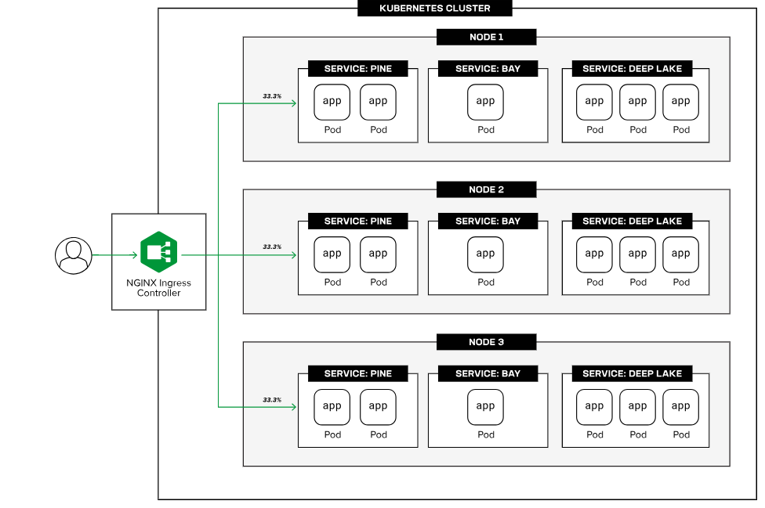
Components in a Kubernetes environment:
Kubernetes Pods, The pod is a “virtual host” for the app container image or images (like a physical server or virtual machine for traditional apps), and it encapsulates one or more containers that share the same compute, storage, and networking resources (and so can be considered to be coupled relatively tightly). Pods are deployed and executed on Kubernetes nodes.
Kubernetes node is the smallest unit of a compute infrastructure. The node can be a virtual machine or a physical server that allocates processor, memory, storage, and networking resources to deploy, run, scale, and manage pods. Nodes are joined together to form a cluster.
Notes:
https://www.f5.com/glossary/kubernetes

Slide 8
Components in a Kubernetes environment:
Kubernetes Clusters, Kubernetes cluster is a group of nodes where pooled compute resources are shared across pods. There are two types of nodes in a cluster:
Worker nodes – Run the containerized apps in the pods
Master nodes – Run the Kubernetes control plane which orchestrates and manages worker nodes and pods
Typically, there is more than one node of each type in a Kubernetes cluster, for high availability and fault tolerance.
Kubernetes Deployments describes how to run an app as a set of replicas (or instances) of the pod in a cluster. A deployment defines:
The number of pod replicas to run
How to roll out pod updates gradually
How to roll back pod replicas to the previous state
How to scale pod replicas horizontally
Kubernetes components:
Kubernetes deployments are made up of nodes, which are physical or virtual machines.
Nodes join together to form a cluster.
Each cluster manages pods, which are the lowest common denominator at the networking and infrastructure level in Kubernetes. One or more pods together make up a service.
Inside each pod resides one or more containers (depending on the application size).

Slide 9
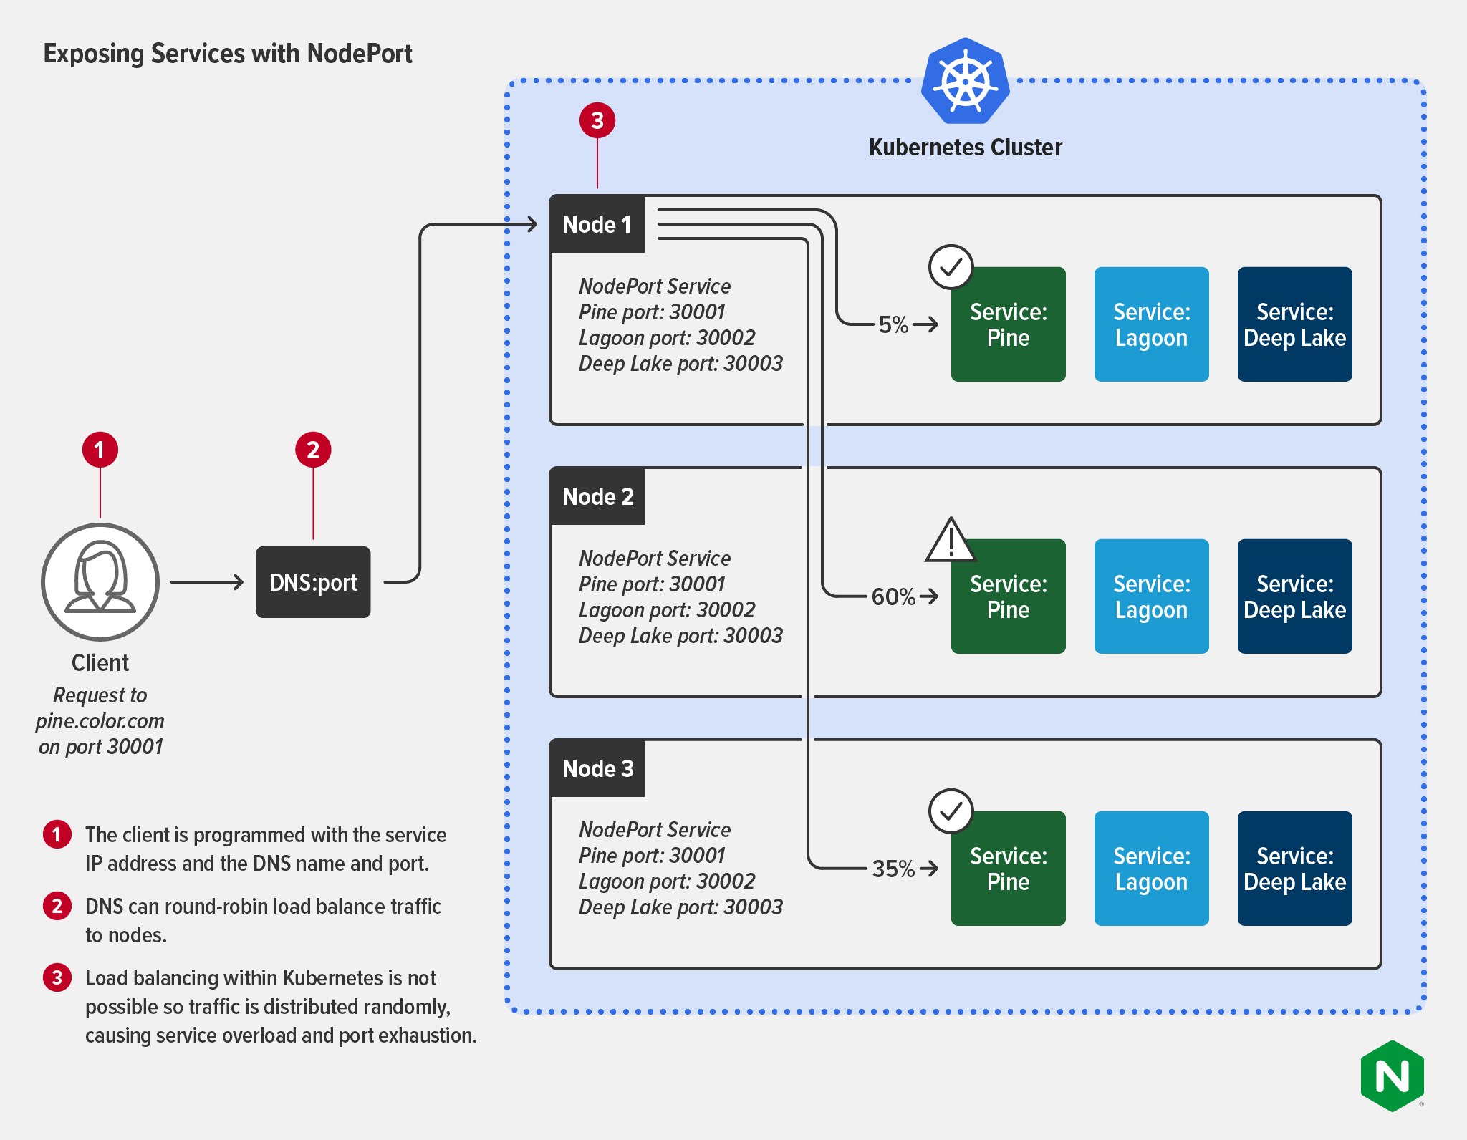
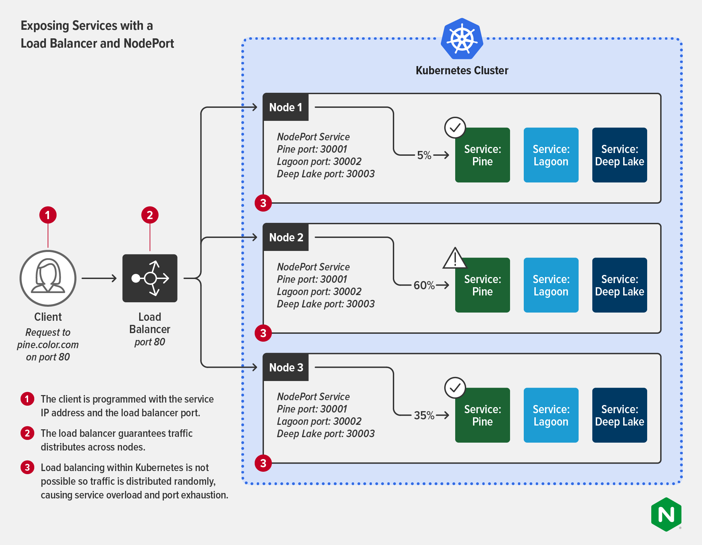
Kubernetes Services
ClusterIP
NodePort
LoadBalancer
Notes:
https://www.f5.com/company/blog/nginx/kubernetes-networking-101
https://www.f5.com/company/blog/nginx/kubernetes-networking-101

Slide 10
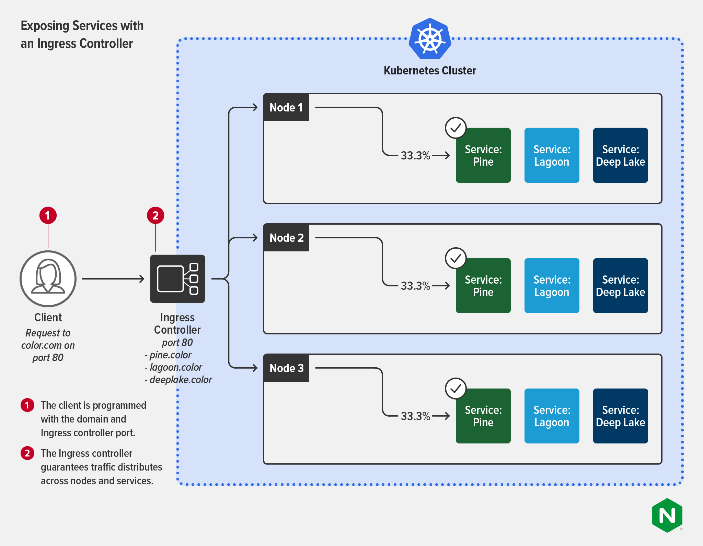
Kubernetes Ingress Controller
Notes:
https://www.f5.com/company/blog/nginx/kubernetes-networking-101

Slide 11
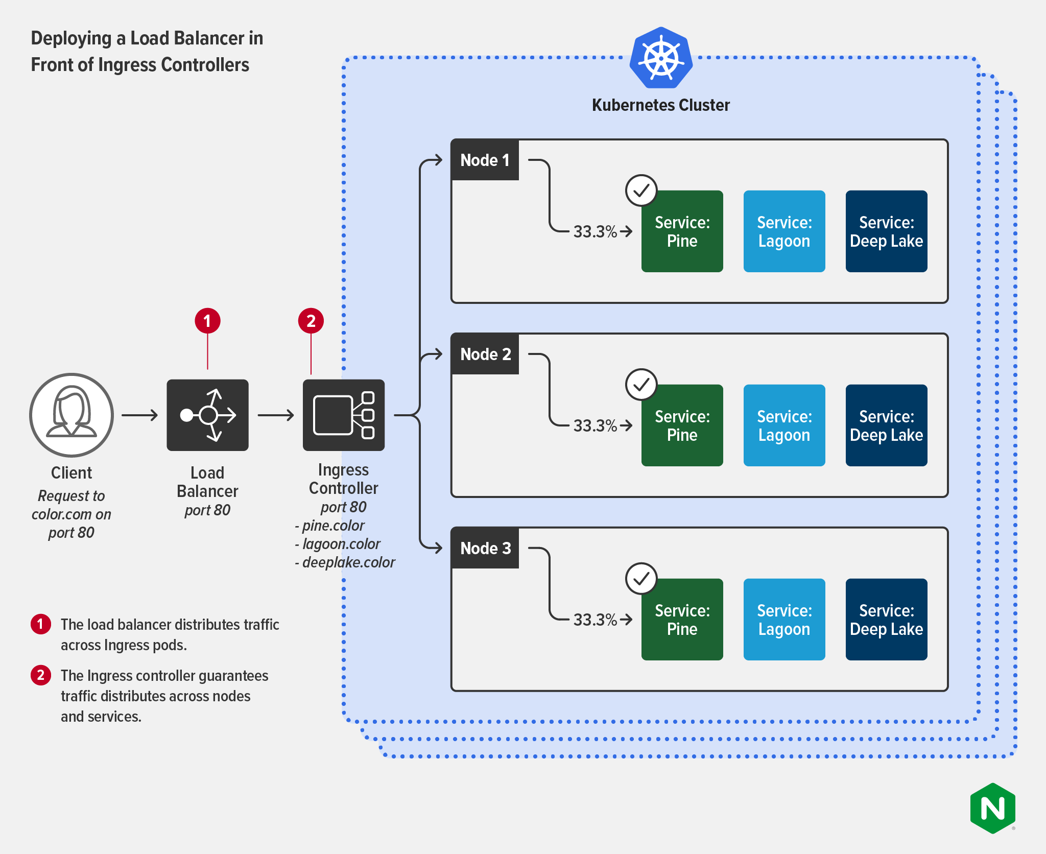
Deploying a Load Balancer with an Ingress Controller
Load balancer (or ADC):
Owner: A NetOps (or maybe SecOps) team
Use case: Outside Kubernetes as the only public‑facing endpoint for services and apps delivered to users outside the cluster. Used as a more generic appliance designed to facilitate security and deliver higher‑level network management.
Ingress controller:
Owner: A Platform Ops or DevOps team
Use case: Inside Kubernetes for fine‑grained load balancing of north‑south traffic (HTTP2, HTTP/HTTPS, SSL/TLS termination, TCP/UDP, WebSocket, gRPC), API gateway functions, and centralized security and identity.
Notes:
https://www.f5.com/company/blog/nginx/kubernetes-networking-101

Slide 12
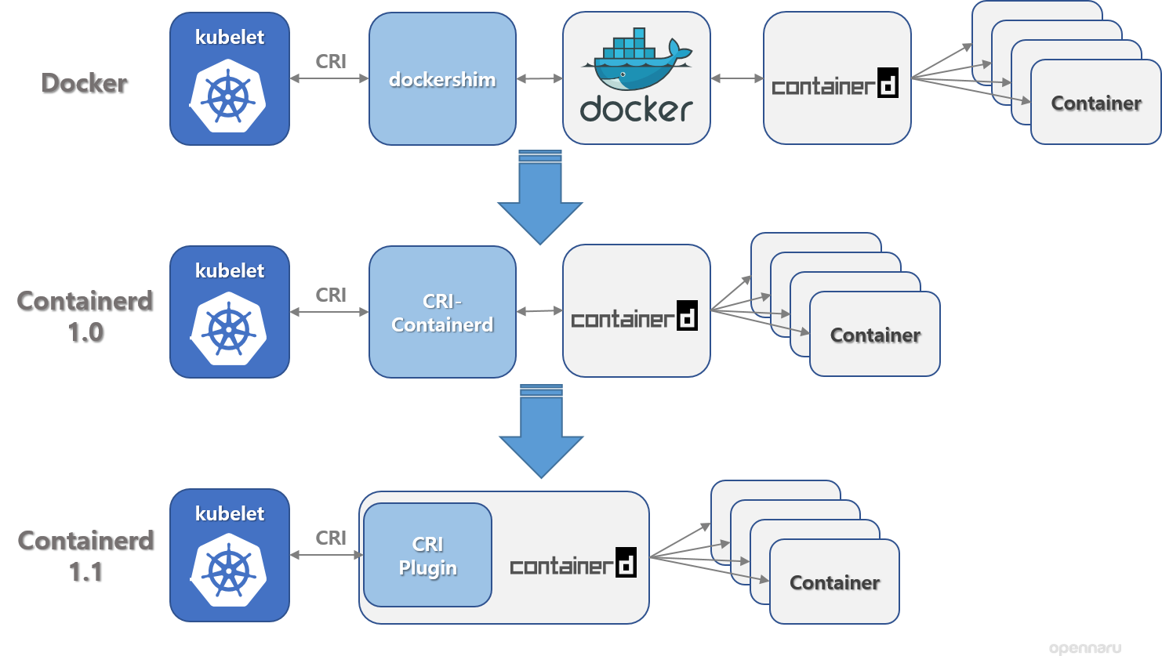
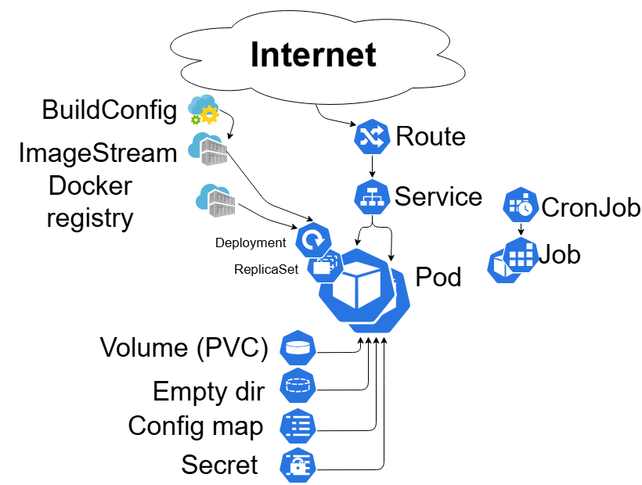
Deploying
PDS
Notes:
https://kubernetes.io/blog/2018/05/24/kubernetes-containerd-integration-goes-ga/

Slide 13
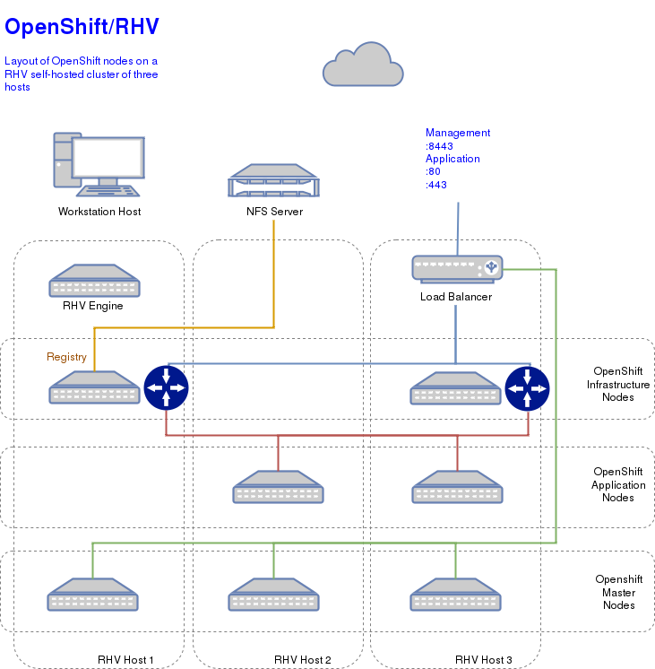
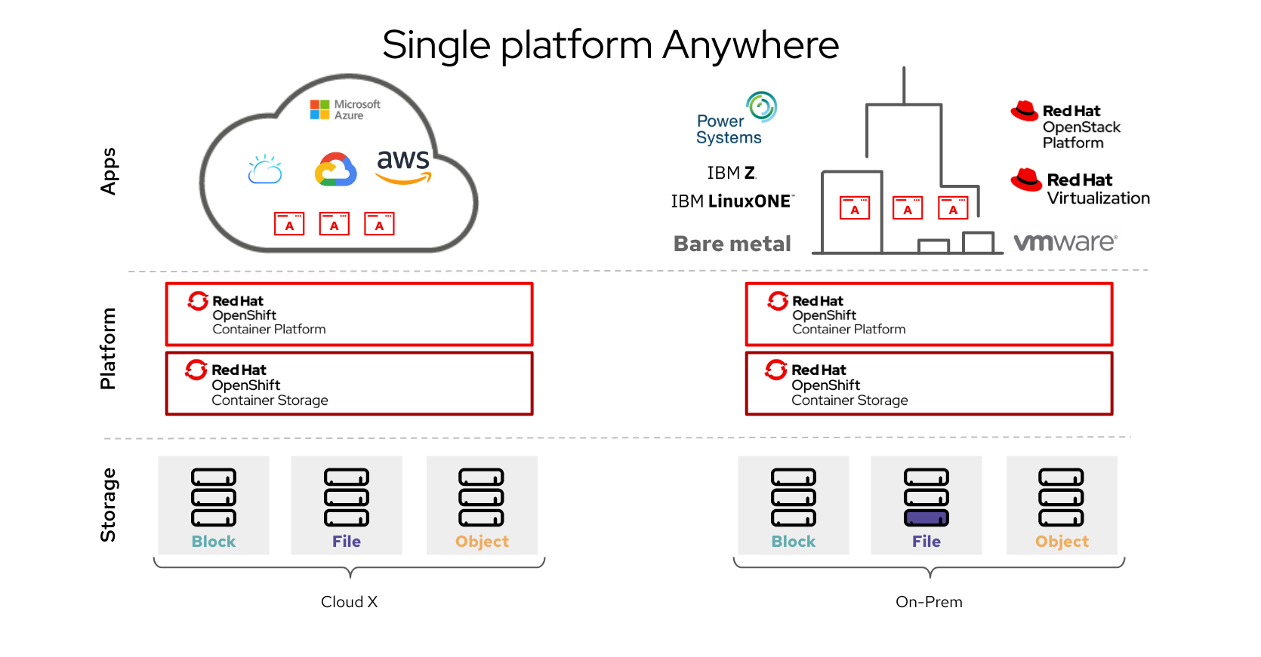
OpenShift
Notes:
https://docs.redhat.com/en/documentation/red_hat_openshift_container_storage/4.2/html/planning_your_deployment/architecture-of-openshift-container-storage_rhocs
https://docs.redhat.com/en/documentation/red_hat_openshift_data_foundation/4.9/html-single/red_hat_openshift_data_foundation_architecture/index
https://docs.redhat.com/en/documentation/red_hat_openshift_container_storage/4.6/html/planning_your_deployment/ocs-architecture_rhocs
Object storage daemons (OSDs)
Monitors (MONs)
Manager (MGR)
Metadata servers (MDS)
Object gateways (RGW) on-premises only

Slide 14
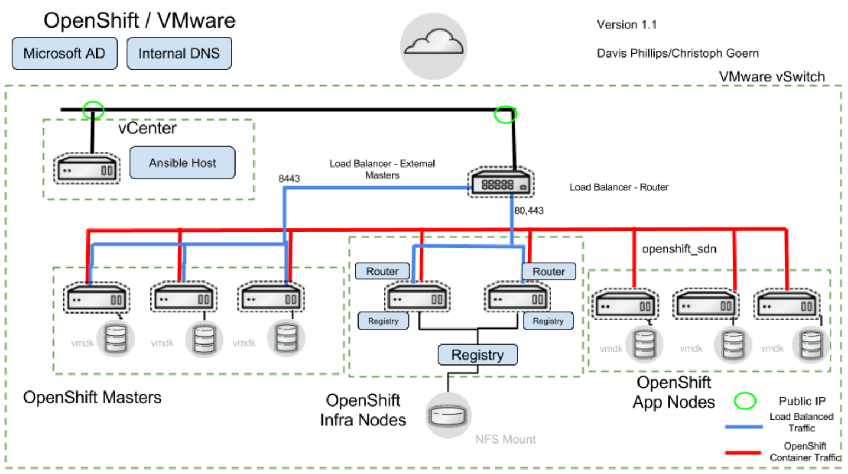
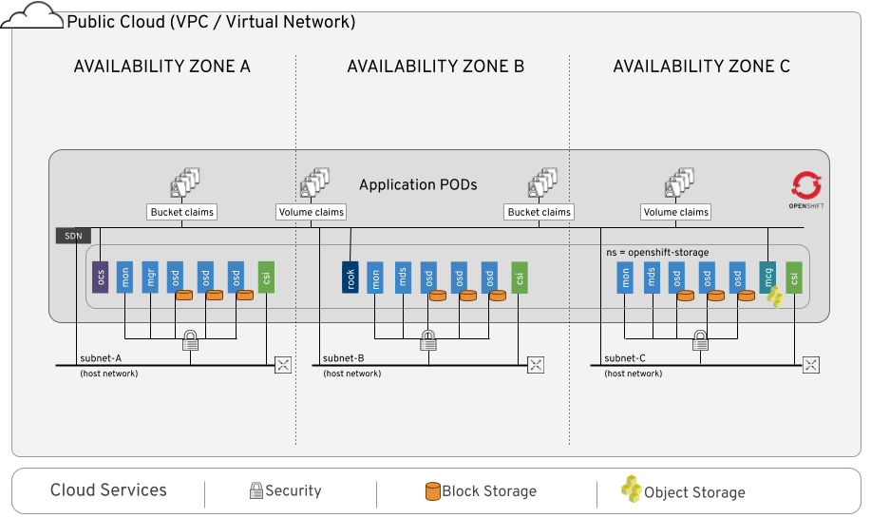
OpenShift
Notes:
https://docs.redhat.com/en/documentation/red_hat_openshift_container_storage/4.2/html/planning_your_deployment/architecture-of-openshift-container-storage_rhocs
https://docs.redhat.com/en/documentation/red_hat_openshift_data_foundation/4.9/html-single/red_hat_openshift_data_foundation_architecture/index

Slide 15
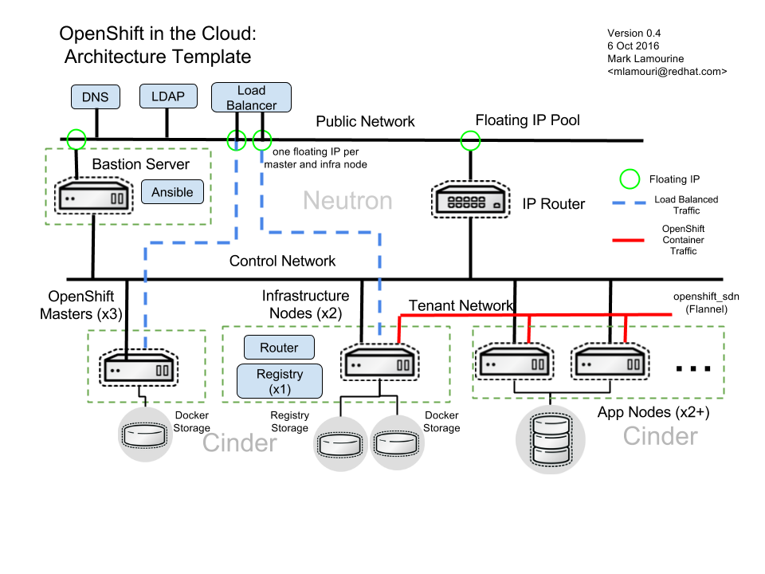
OpenShift
Notes:
https://docs.redhat.com/en/documentation/red_hat_openshift_container_storage/4.2/html/planning_your_deployment/architecture-of-openshift-container-storage_rhocs
https://docs.redhat.com/en/documentation/red_hat_openshift_data_foundation/4.9/html-single/red_hat_openshift_data_foundation_architecture/index

Slide 16
Start to Build Deploy Cloud with Kubernetes
Create Cloud with Kubernetes: Orchestrating Containers
Notes:
https://kubernetes.io/blog/2024/04/05/diy-create-your-own-cloud-with-kubernetes-part-3/

Slide 17
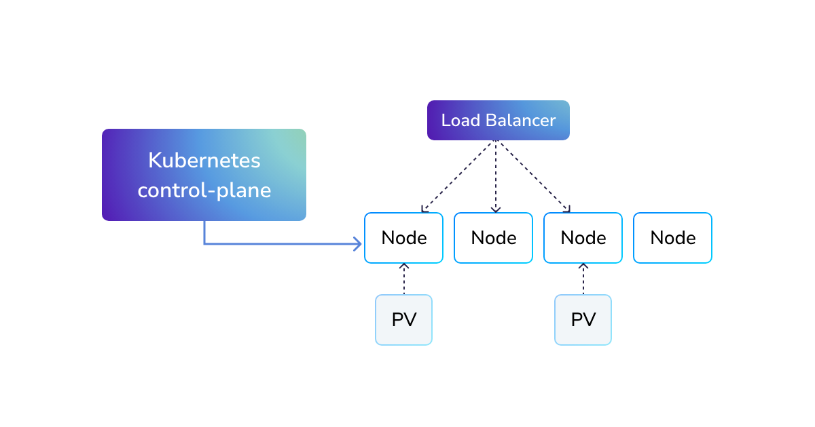
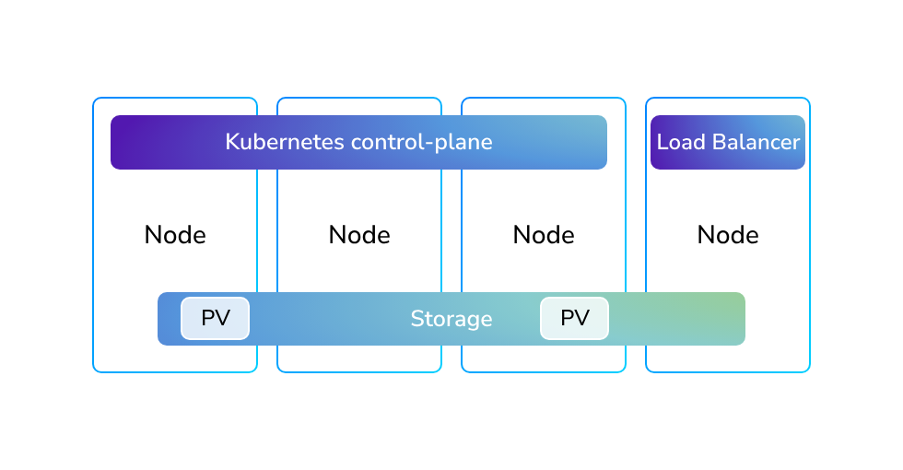
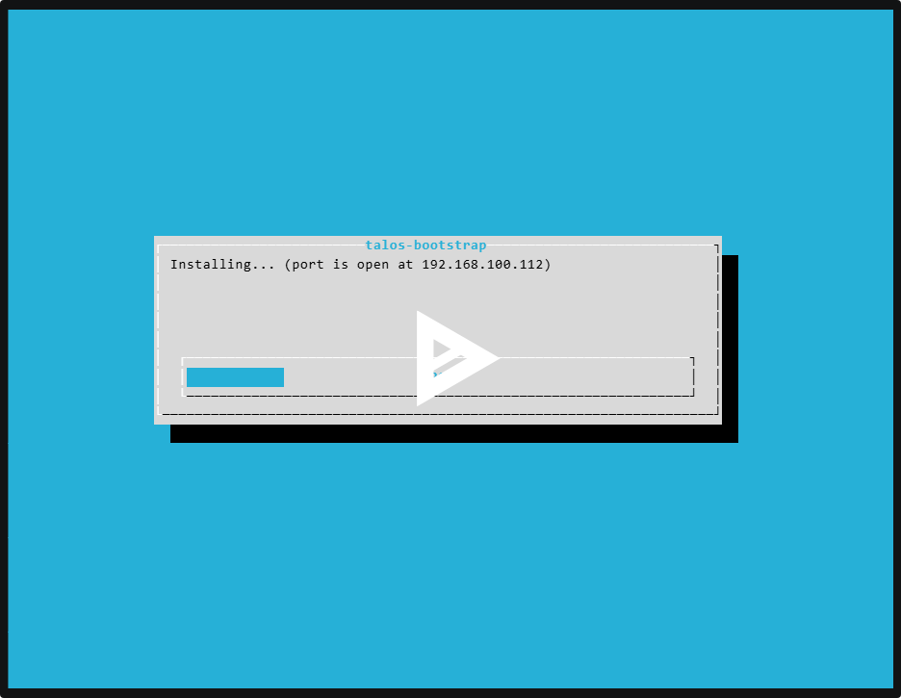
Create Cloud with Kubernetes: Orchestrating Containers
A series consisting of several parts:
Part 1: Preparing the groundwork for your cloud. Challenges faced during the preparation and operation of Kubernetes on bare metal and a ready-made recipe for provisioning infrastructure.
Part 2: Networking, storage, and virtualization. How to turn Kubernetes into a tool for launching virtual machines and what is needed for this.
Part 3: Cluster API and how to start provisioning Kubernetes clusters at the push of a button. How autoscaling works, dynamic provisioning of volumes, and load balancers.
Kubernetes in the cloud
arch: amd64
platform: metal
secureboot: false
version: v1.6.4
input:
kernel:
path: /usr/install/amd64/vmlinuz
initramfs:
path: /usr/install/amd64/initramfs.xz
baseInstaller:
imageRef: ghcr.io/siderolabs/installer:v1.6.4
systemExtensions:
- imageRef: ghcr.io/siderolabs/amd-ucode:20240115
- imageRef: ghcr.io/siderolabs/amdgpu-firmware:20240115
- imageRef: ghcr.io/siderolabs/bnx2-bnx2x:20240115
- imageRef: ghcr.io/siderolabs/i915-ucode:20240115
- imageRef: ghcr.io/siderolabs/intel-ice-firmware:20240115
- imageRef: ghcr.io/siderolabs/intel-ucode:20231114
- imageRef: ghcr.io/siderolabs/qlogic-firmware:20240115
- imageRef: ghcr.io/siderolabs/drbd:9.2.6-v1.6.4
- imageRef: ghcr.io/siderolabs/zfs:2.1.14-v1.6.4
output:
kind: installer
outFormat: raw
Kubernetes on bare metal
cat config.yaml | docker run --rm -i -v /dev:/dev --privileged "ghcr.io/siderolabs/imager:v1.6.4" -
Notes:
https://kubernetes.io/blog/2024/04/05/diy-create-your-own-cloud-with-kubernetes-part-1/
https://kubernetes.io/blog/2024/04/05/diy-create-your-own-cloud-with-kubernetes-part-2/

Slide 18
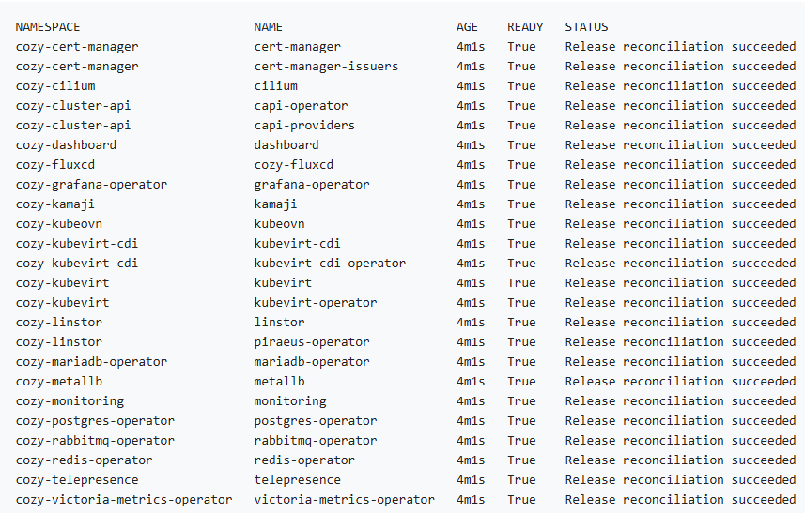
Create Cloud with Kubernetes: Orchestrating Containers
Delivering system components
Notes:
https://kubernetes.io/blog/2024/04/05/diy-create-your-own-cloud-with-kubernetes-part-1/

Slide 19
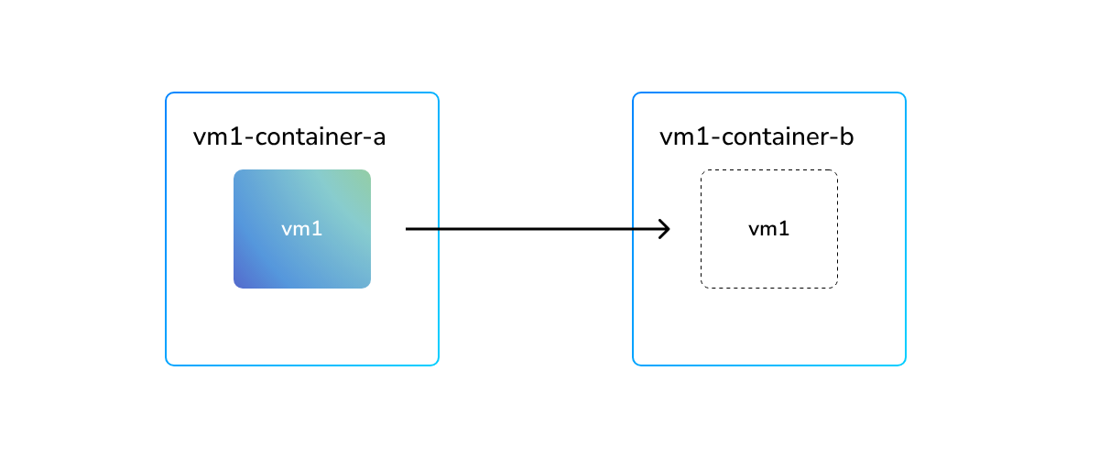
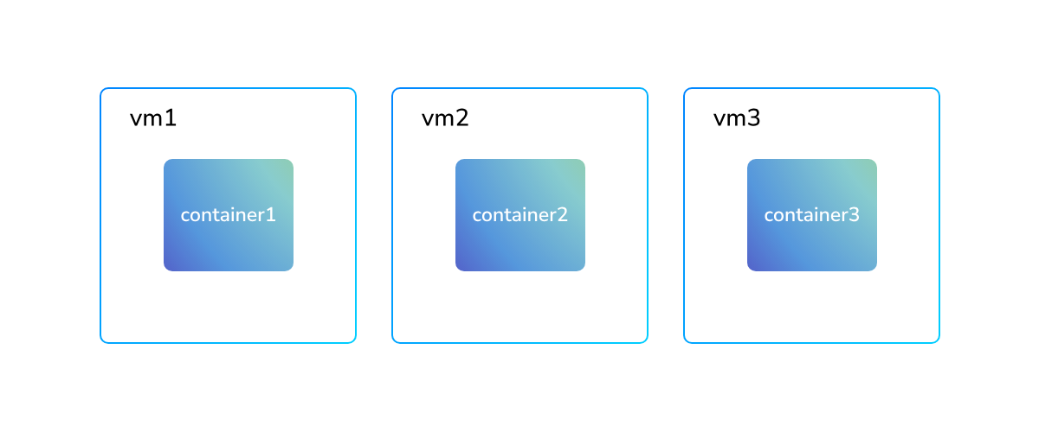
Create Cloud with Kubernetes: Orchestrating Containers
Virtualization technologies
KubeVir
KubeVirt allows running traditional virtual machines using the Kubernetes API. KubeVirt virtual machines are run as regular linux processes in containers.
Kubernetes world: KubeVirt and Kata Containers
Kata Containers implements the CRI (Container Runtime Interface) and provides an additional level of isolation for standard containers by running them in virtual machines.
Notes:
https://kubernetes.io/blog/2024/04/05/diy-create-your-own-cloud-with-kubernetes-part-1/

Slide 20
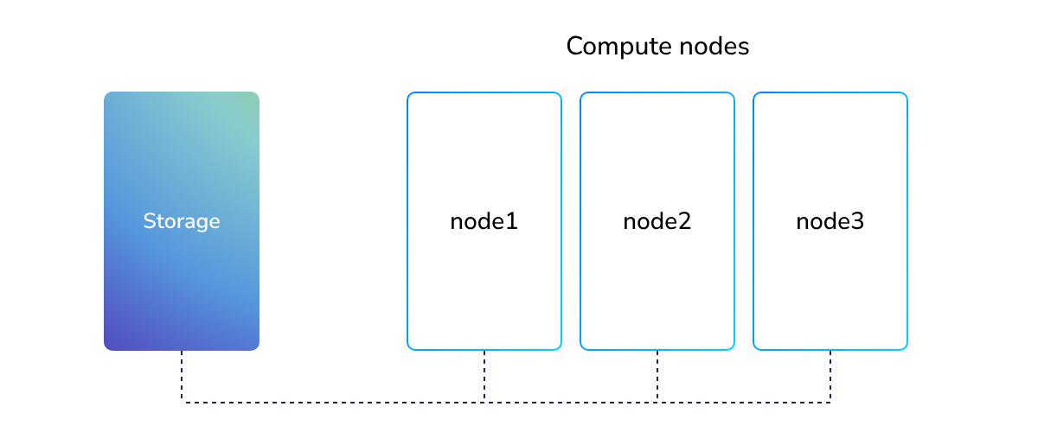
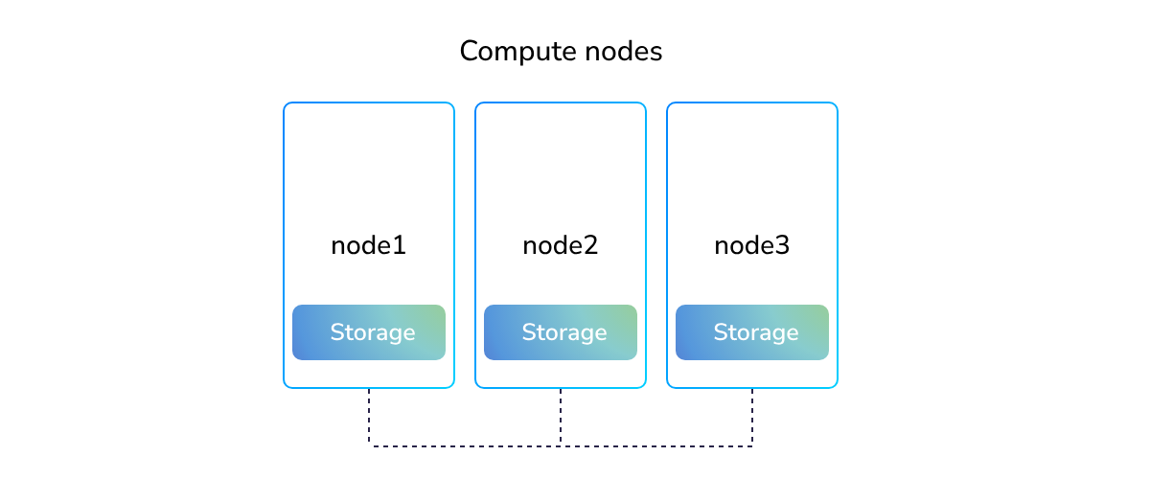
Create Cloud with Kubernetes: Orchestrating Containers
Storage for Kubernetes VMs
the CSI (Container Storage Interface), KubeVirt fully utilizes the CSI interface, aligning the choice of storage for virtualization
External storage
the cluster - the CSI driver, This driver is responsible for provisioning volumes in this storage and attaching them to pods run by Kubernetes, solutions is TrueNAS powered by democratic-csi driver.
Fig. A diagram showing external data storage communication with the compute nodes
Notes:
https://kubernetes.io/blog/2024/04/05/diy-create-your-own-cloud-with-kubernetes-part-1/

Slide 21
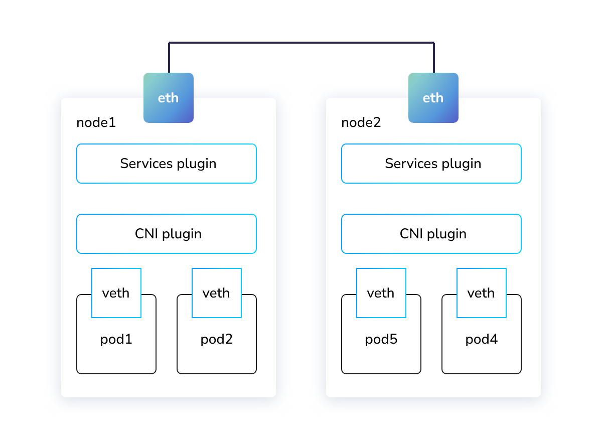
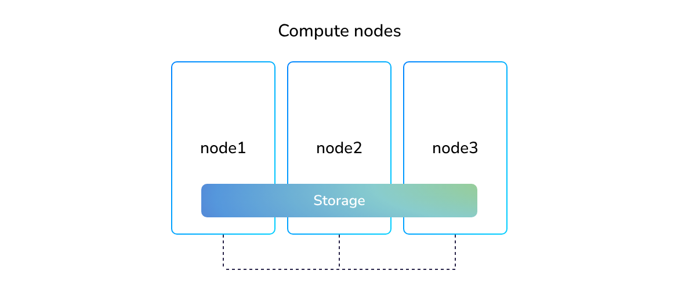
Create Cloud with Kubernetes: Orchestrating Containers
Hyper-converged systems are often implemented using local storage (when you do not need replication) and with software-defined storages, often installed directly in Kubernetes, such as Rook/Ceph, OpenEBS, Longhorn, LINSTOR, and others.
A hyper-converged system has its advantages. For example, data locality: when your data is stored locally, access to such data is faster. But there are disadvantages as such a system is usually more difficult to manage and maintain.
Networking for Kubernetes VMs
Node Network (Data Center Network)
Fig. The node network (data center network) on the Kubernetes networking
Notes:
https://kubernetes.io/blog/2024/04/05/diy-create-your-own-cloud-with-kubernetes-part-1/

Slide 22
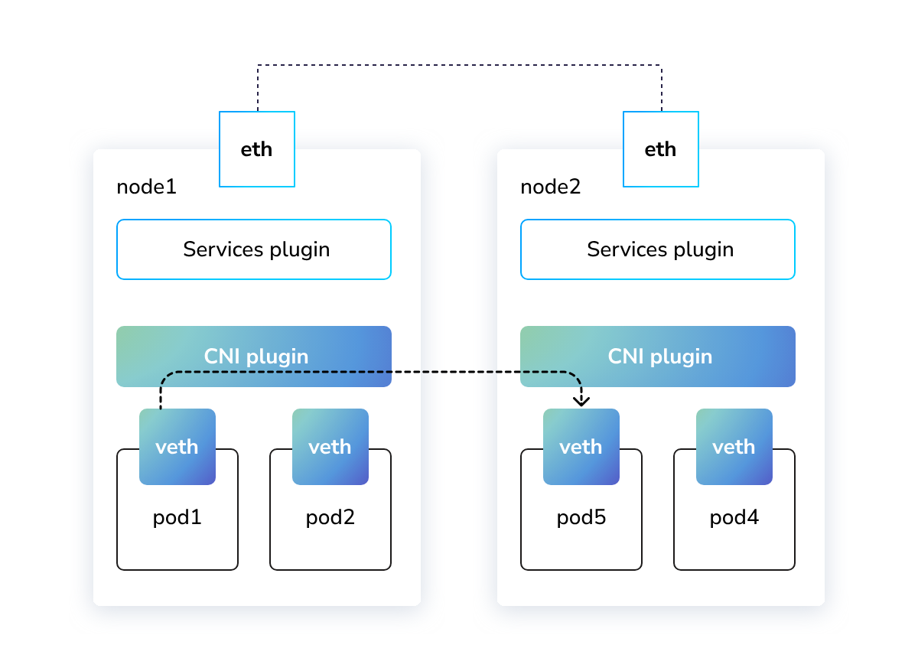
Create Cloud with Kubernetes: Orchestrating Containers
Pod Network
This is the network provided by your CNI plugin. The task of the CNI plugin is to ensure transparent connectivity between all containers and nodes in the cluster. Most CNI plugins implement a flat network from which separate blocks of IP addresses are allocated for use on each node.
cluster can have several CNI plugins managed by Multus. This approach is often used in virtualization solutions based on KubeVirt - Rancher and OpenShift. The primary CNI plugin is used for integration with Kubernetes services, while additional CNI plugins are used to implement private networks (VPC) and integration with the physical networks of your data center.
The default CNI-plugins can be used to connect bridges or physical interfaces. Additionally, there are specialized plugins such as macvtap-cni which are designed to provide more performance.
Fig. The role of the pod network (CNI-plugin) on the Kubernetes network
Notes:
https://kubernetes.io/blog/2024/04/05/diy-create-your-own-cloud-with-kubernetes-part-1/

Slide 23
Create Cloud with Kubernetes: Orchestrating Containers
Pod Network (Cons’t)
Kubernetes is the need for IPAM (IP Address Management), especially for secondary interfaces provided by Multus.
This is commonly managed by a DHCP server operating within your infrastructure. Additionally, the allocation of MAC addresses for virtual machines can be managed by Kubemacpool.
ully rely on Kube-OVN. This CNI plugin is based on OVN (Open Virtual Network) which was originally developed for OpenStack and it provides a complete network solution for virtual machines in Kubernetes, features Custom Resources for managing IPs and MAC addresses, supports live migration with preserving IP addresses between the nodes, and enables the creation of VPCs for physical network separation between tenants.
Notes:
https://kubernetes.io/blog/2024/04/05/diy-create-your-own-cloud-with-kubernetes-part-1/

Slide 24
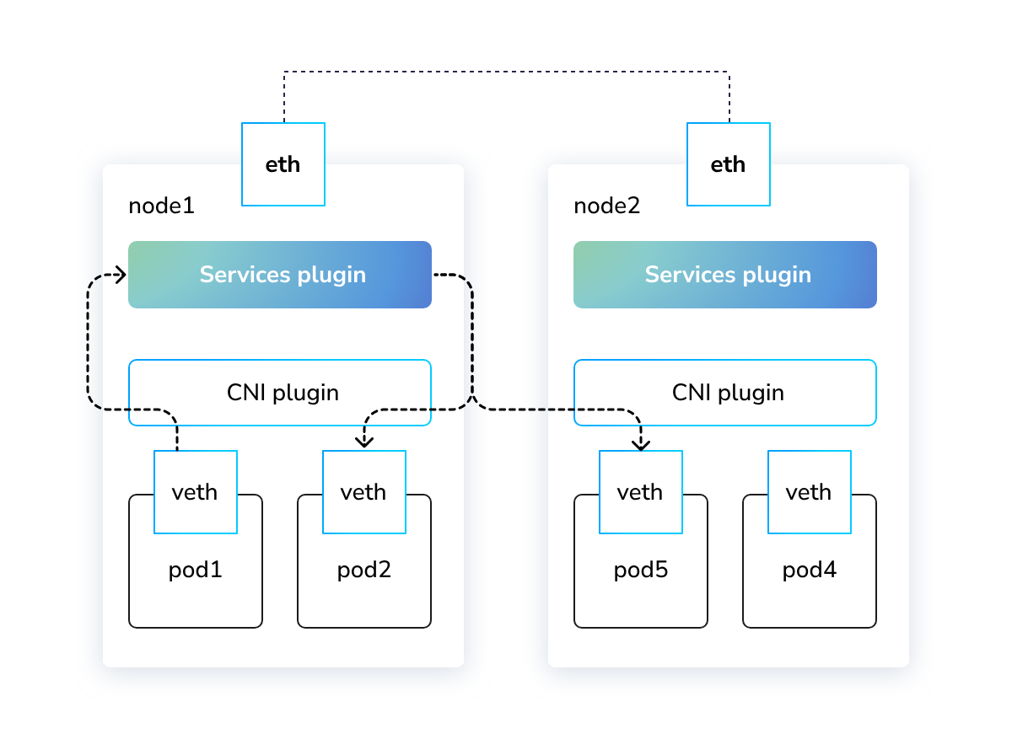
Create Cloud with Kubernetes: Orchestrating Containers
Services Network
n addition to the CNI plugin, Kubernetes also has a services network, which is primarily needed for service discovery. Contrary to traditional virtual machines, Kubernetes is originally designed to run pods with a random address. And the services network provides a convenient abstraction (stable IP addresses and DNS names) that will always direct traffic to the correct pod. The same approach is also commonly used with virtual machines in clouds despite the fact that their IPs are usually static.
the services network plugin, The standard implementation is called kube-proxy and is used in most clusters. But nowadays, this functionality might be provided as part of the CNI plugin. The most advanced implementation is offered by the Cilium project, which can be run in kube-proxy replacement mode. ilium and Kube-OVN can be easily integrated to provide a unified solution that offers seamless, multi-tenant networking for virtual machines, as well as advanced network policies and combined services network functionality
Fig. the role of the services network (services network plugin) on the Kubernetes network
Notes:
https://kubernetes.io/blog/2024/04/05/diy-create-your-own-cloud-with-kubernetes-part-1/

Slide 25
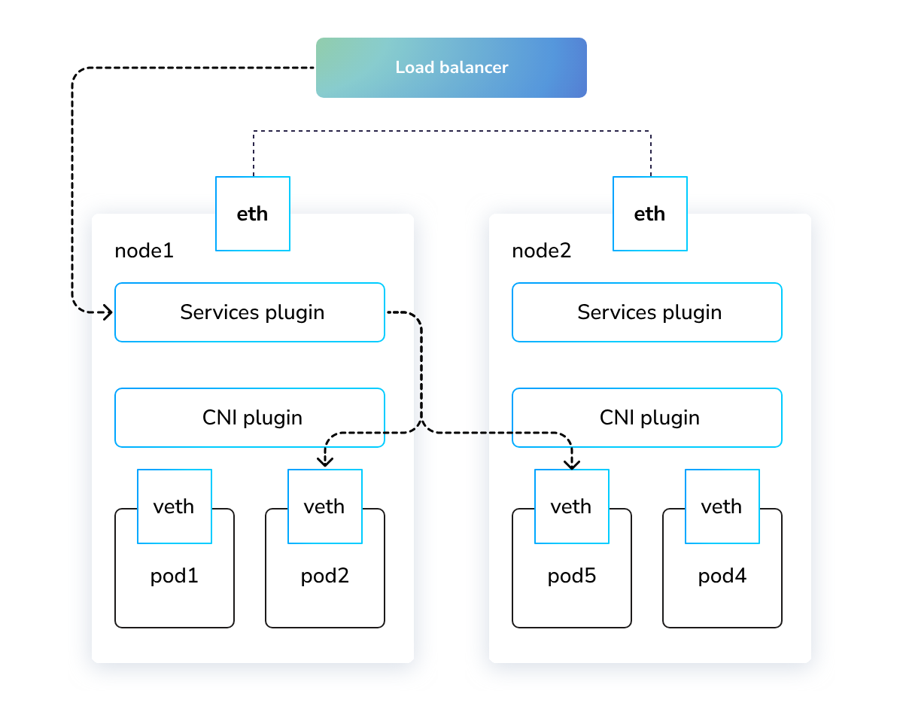
Create Cloud with Kubernetes: Orchestrating Containers
External Traffic Load Balancer
Services from outside your cluster, and an external load balancer will help you with organizing this.
For bare metal Kubernetes clusters, there are several load balancers available: MetalLB, kube-vip, LoxiLB, also Cilium and Kube-OVN provides built-in implementation.
Setting up a load balancer on bare metal is achieved by creating floating IP address on the nodes within the cluster, and announce it externally using ARP/NDP or BGP protocols.
After exploring various options, we decided that MetalLB is the simplest and most reliable solution, although we do not strictly enforce the use of only it.
Another benefit is that in L2 mode, MetalLB speakers continuously check their neighbour's state by sending preforming liveness checks using a memberlist protocol. This enables failover that works independently of Kubernetes control-plane
Fig. the role of the external load balancer on the Kubernetes network
Notes:
https://kubernetes.io/blog/2024/04/05/diy-create-your-own-cloud-with-kubernetes-part-1/

Slide 26
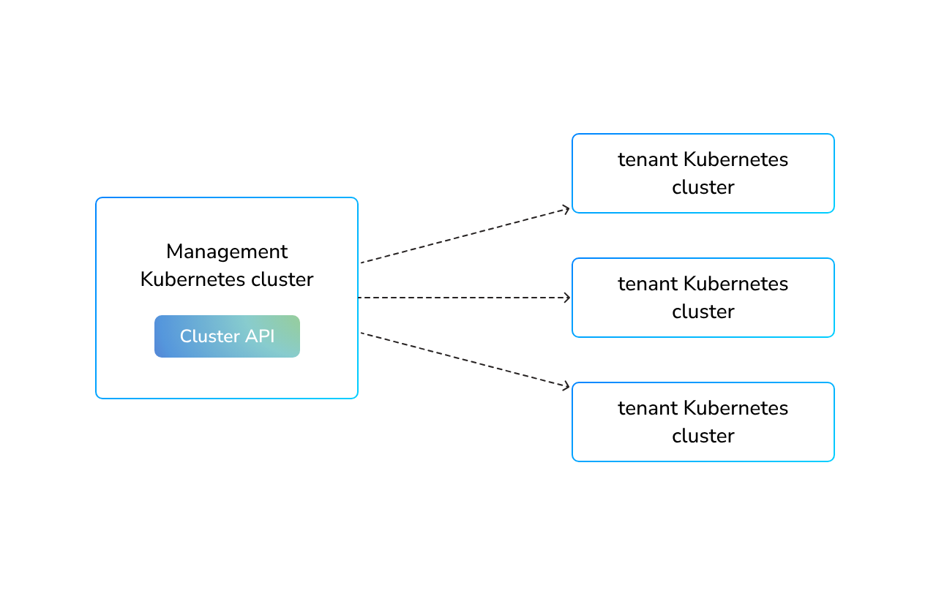
Create Cloud with Kubernetes: Orchestrating Containers
Cluster API
Cluster API, there are two terms: management cluster and tenant clusters.
Management cluster is a Kubernetes cluster used to deploy and manage other clusters. This cluster contains all the necessary Cluster API components and is responsible for describing, creating, and updating tenant clusters. It is often used just for this purpose.
Tenant clusters are the user clusters or clusters deployed using the Cluster API. They are created by describing the relevant resources in the management cluster. They are then used for deploying applications and services by end-users.
Fig. Management Kubernetes cluster and tenant Kubernetes clusters using Cluster API
Notes:
https://kubernetes.io/blog/2024/04/05/diy-create-your-own-cloud-with-kubernetes-part-1/
https://kubernetes.io/blog/2024/04/05/diy-create-your-own-cloud-with-kubernetes-part-3/

Slide 27
Create Cloud with Kubernetes: Orchestrating Containers
Cluster API (Cons’t)
Cluster API utilizes the concept of providers which are separate controllers responsible for specific components of the cluster being created. Within Cluster API, there are several types of providers. The major ones are:
Infrastructure Provider, which is responsible for providing the computing infrastructure, such as virtual machines or physical servers.
Control Plane Provider, which provides the Kubernetes control plane, namely the components kube-apiserver, kube-scheduler, and kube-controller-manager.
Bootstrap Provider, which is used for generating cloud-init configuration for the virtual machines and servers being created.
Notes:
https://kubernetes.io/blog/2024/04/05/diy-create-your-own-cloud-with-kubernetes-part-1/

Slide 28
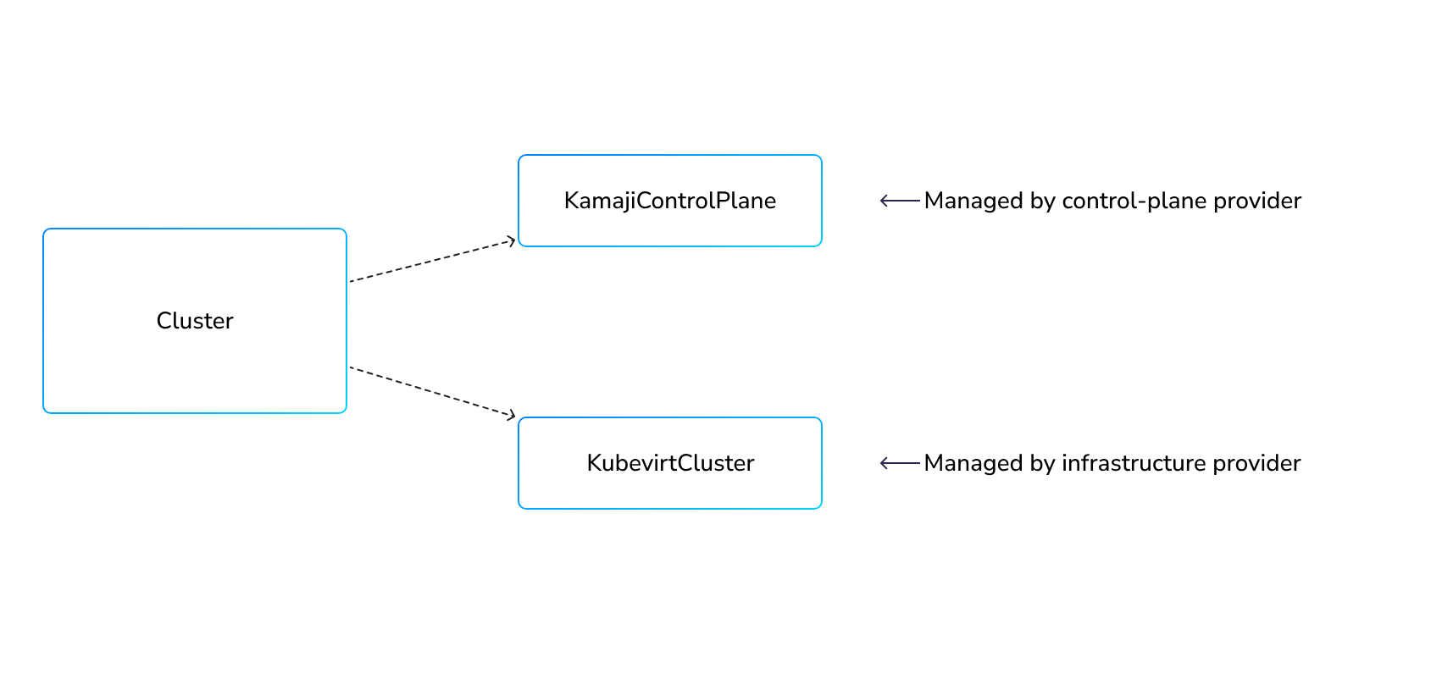
Create Cloud with Kubernetes: Orchestrating Containers
Choosing providers
Infrastructure provider
To run Kubernetes clusters using KubeVirt, the KubeVirt Infrastructure Provider must be installed. It enables the deployment of virtual machines for worker nodes in the same management cluster, where the Cluster API operates.
Control plane provider
This approach has several significant advantages:
Cost-effectiveness: Running the control plane in containers avoids the use of separate control plane nodes for each cluster, thereby significantly reducing infrastructure costs.
Stability: Simplifying architecture by eliminating complex multi-layered deployment schemes. Instead of sequentially launching a virtual machine and then installing etcd and Kubernetes components inside it, there's a simple control plane that is deployed and run as a regular application inside Kubernetes and managed by an operator.
Security: The cluster's control plane is hidden from the end user, reducing the possibility of its components being compromised, and also eliminates user access to the cluster's certificate store. This approach to organizing a control plane invisible to the user is often used by cloud providers
Bootstrap provider
Kubeadm as the Bootstrap Provider - as the standard method for preparing clusters in Cluster API. This provider is developed as part of the Cluster API itself. It requires only a prepared system image with kubelet and kubeadm installed and allows generating configs in the cloud-init and ignition formats.
How it works
Notes:
https://kubernetes.io/blog/2024/04/05/diy-create-your-own-cloud-with-kubernetes-part-1/

Slide 29
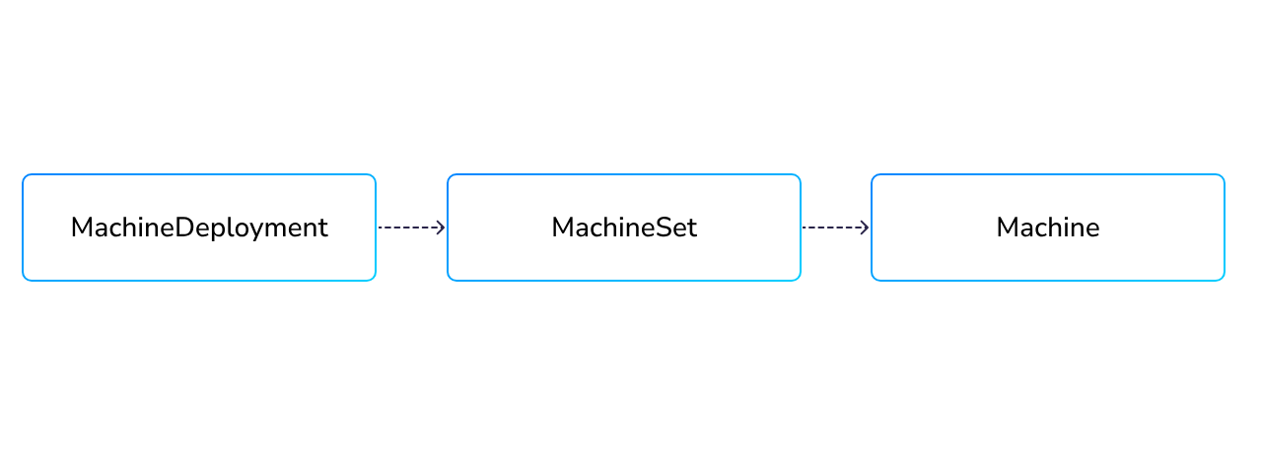
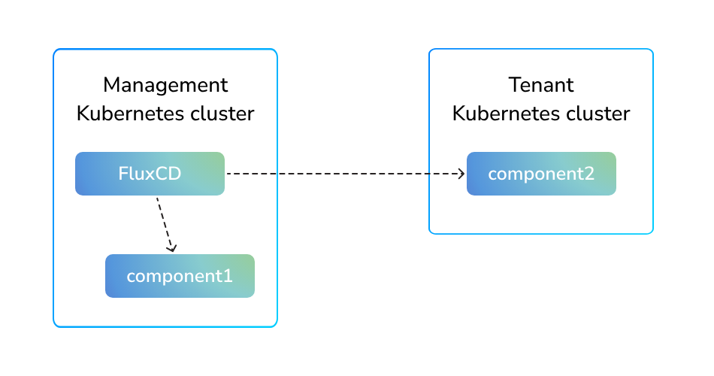



Notes:
https://kubernetes.io/blog/2024/04/05/diy-create-your-own-cloud-with-kubernetes-part-3/

Slide 30
The End
Thx

